Slide 1


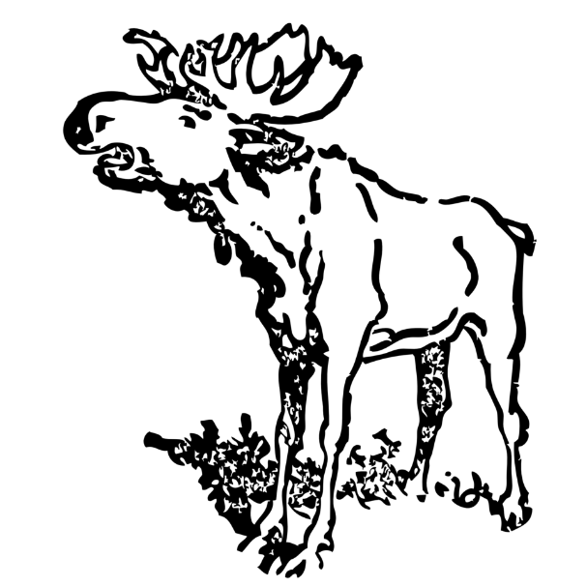





Using Ancient sedDNA to Detect Moose
Arrival Time
Moose on the Loose
Samantha N. Hershauer, Colin J. Sobek, Carol L. Chambers, Viacheslav Y. Fofanov, Darrell S. Kaufman, Faith M. Walker

Slide 2
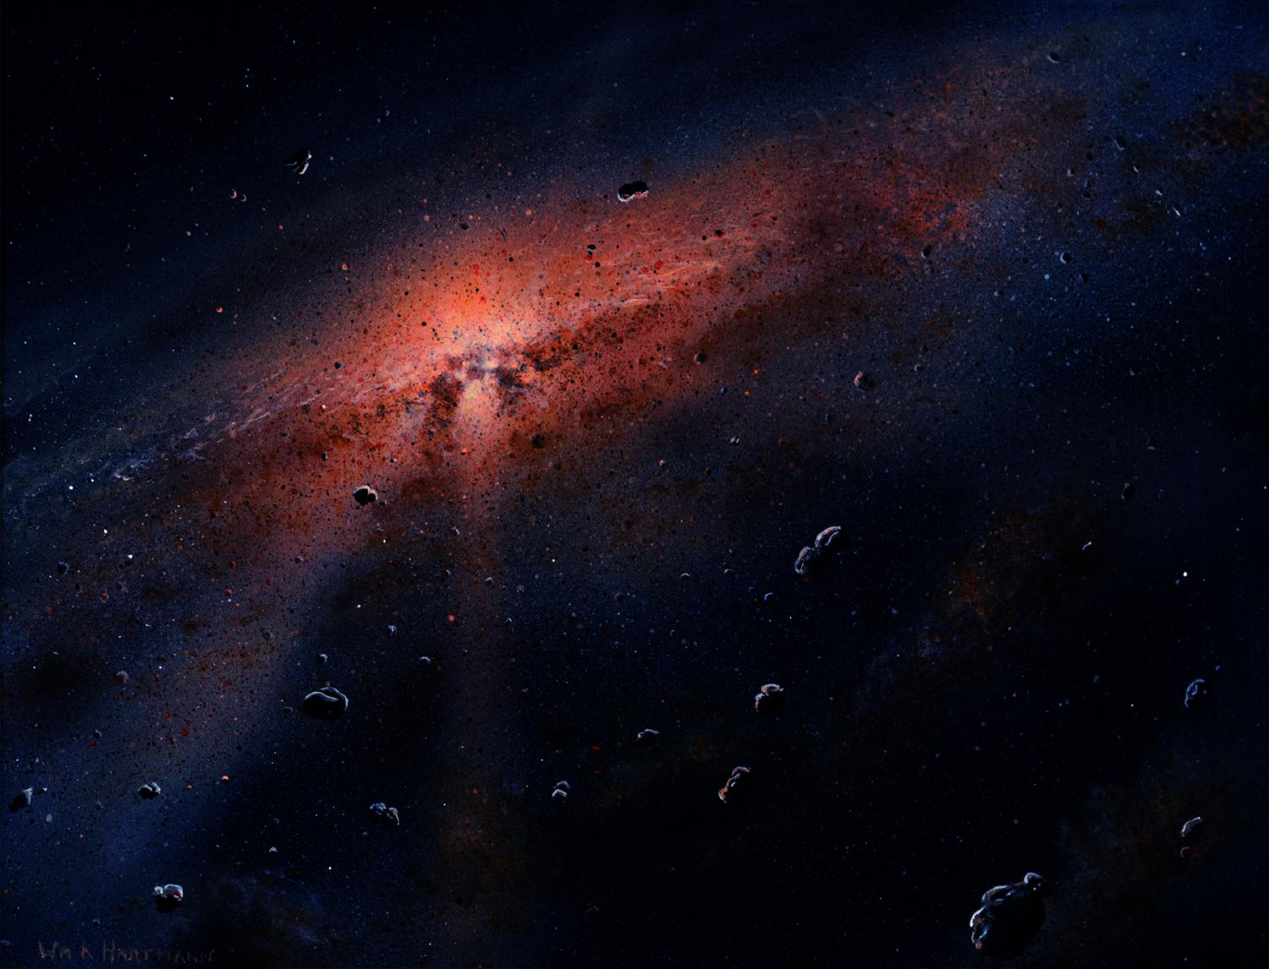
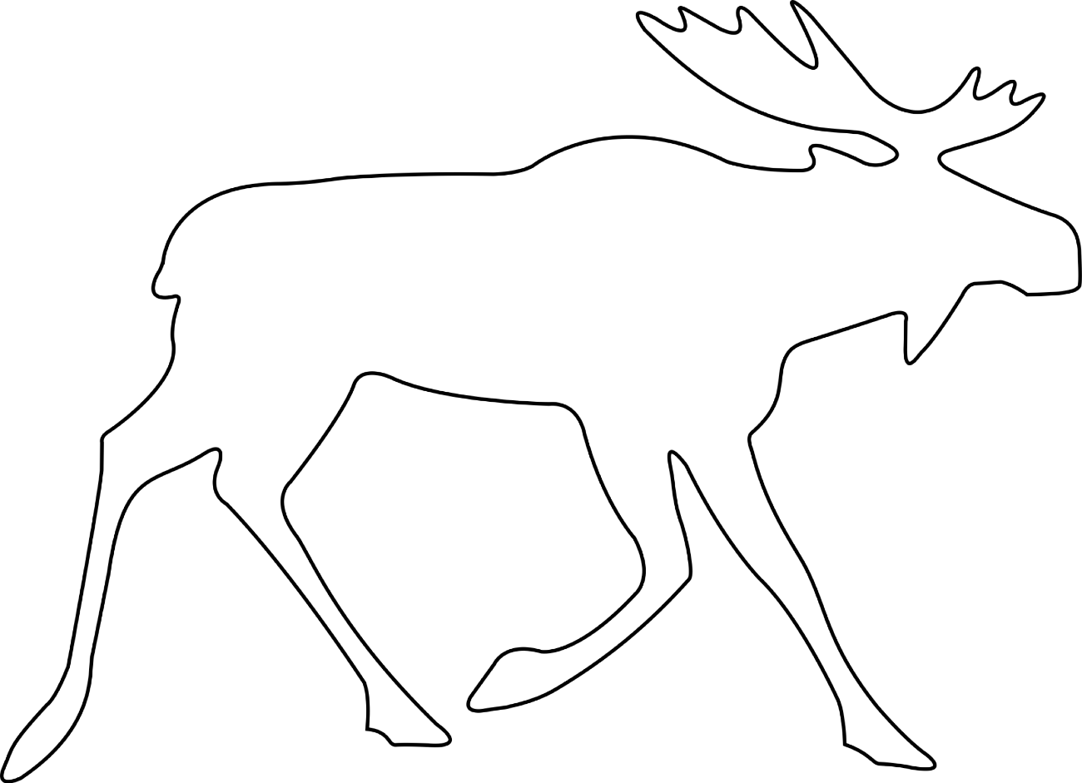

Slide 3
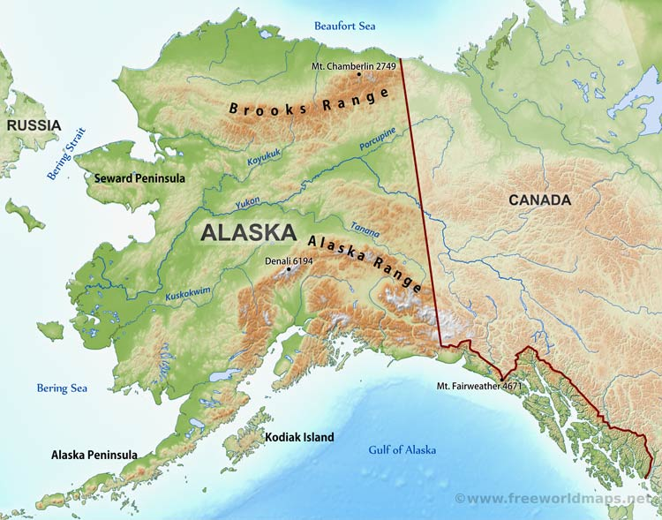

.
Anchorage
Kenai Peninsula

Slide 4
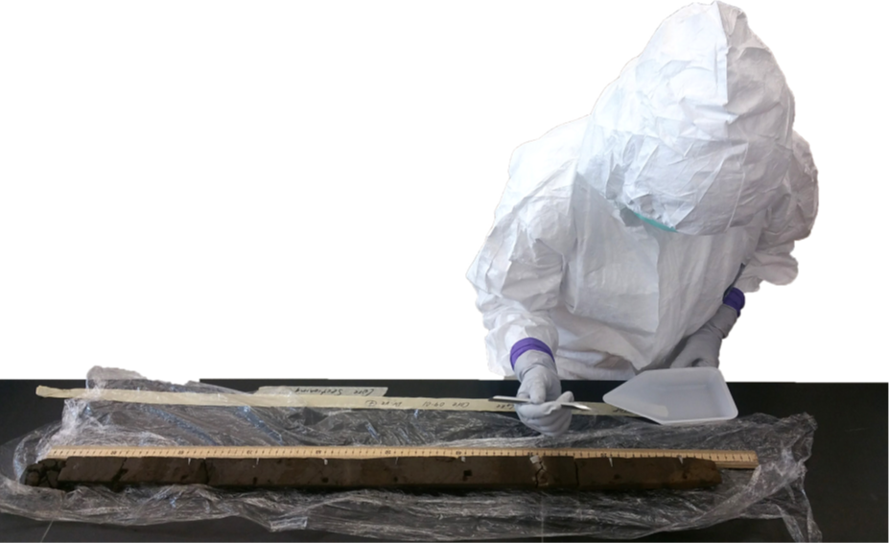
Sediment Cores

Slide 5
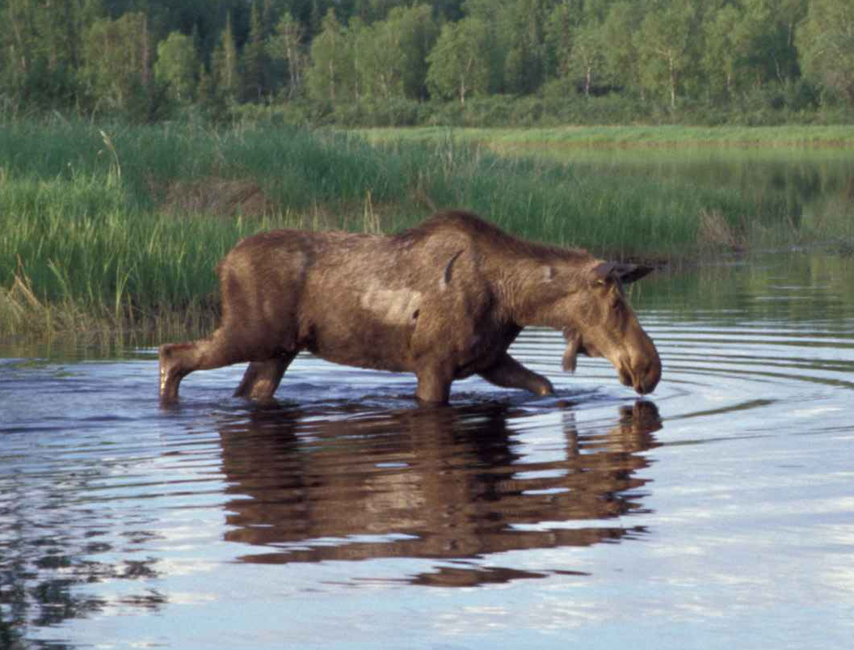



Kenai Peninsula
Present
Older DNA
150 ya

Slide 6
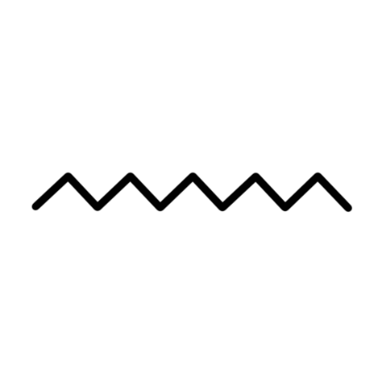
First Attempt: 12s
Primers
First Attempt: 12s
Primers
Primers
DNA
Moose?

Slide 7
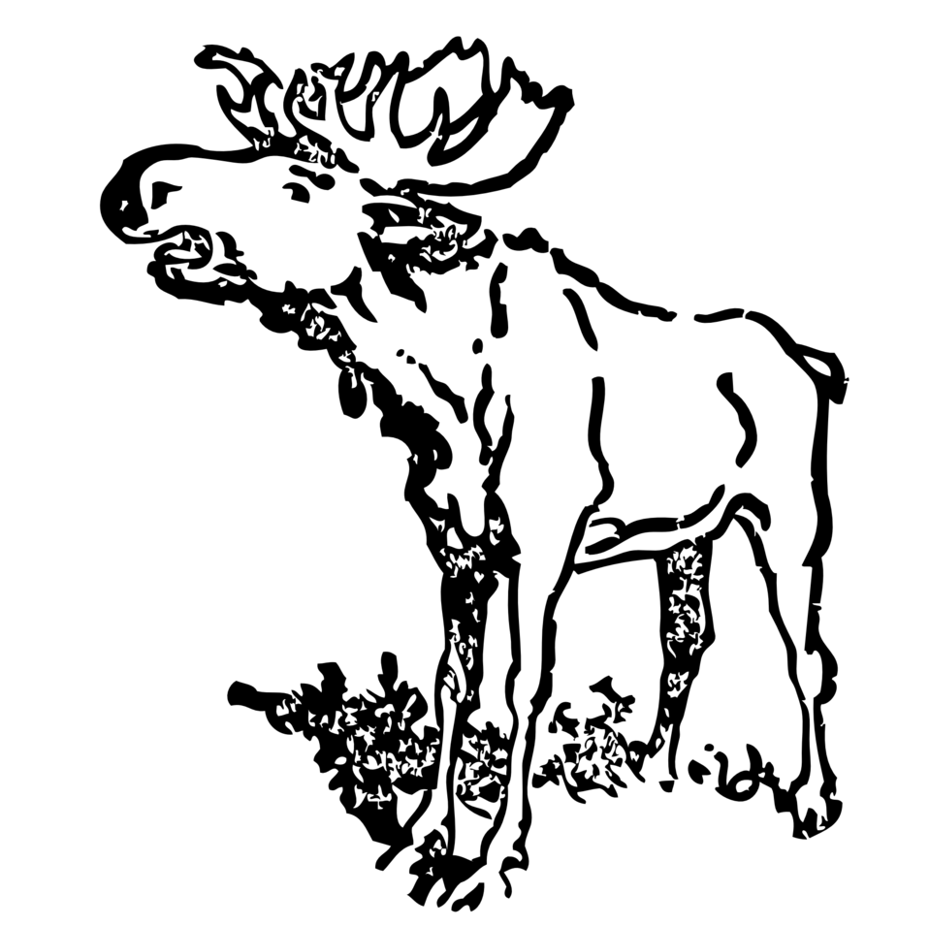
Second Attempt: CytB
Primers

Slide 8
Primer Creation
Moose DNA

Slide 9
Testing with Moose Poop
100 bp

Slide 10
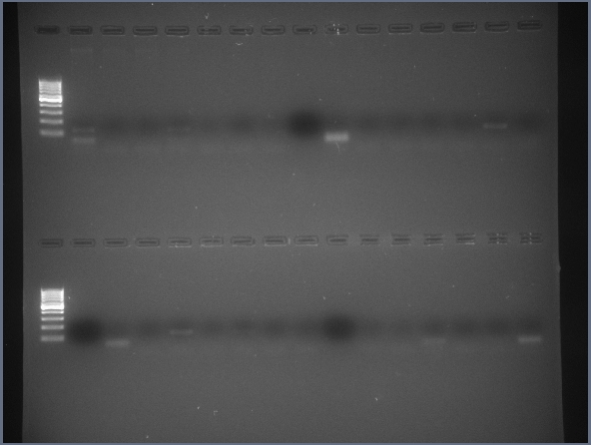
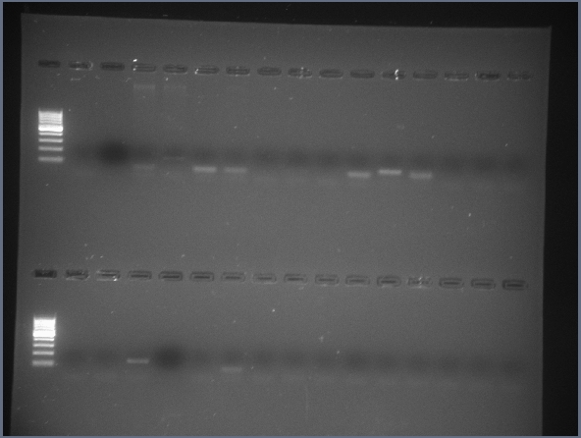
Applying to Sediment

Slide 11
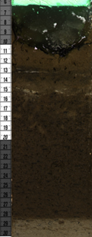
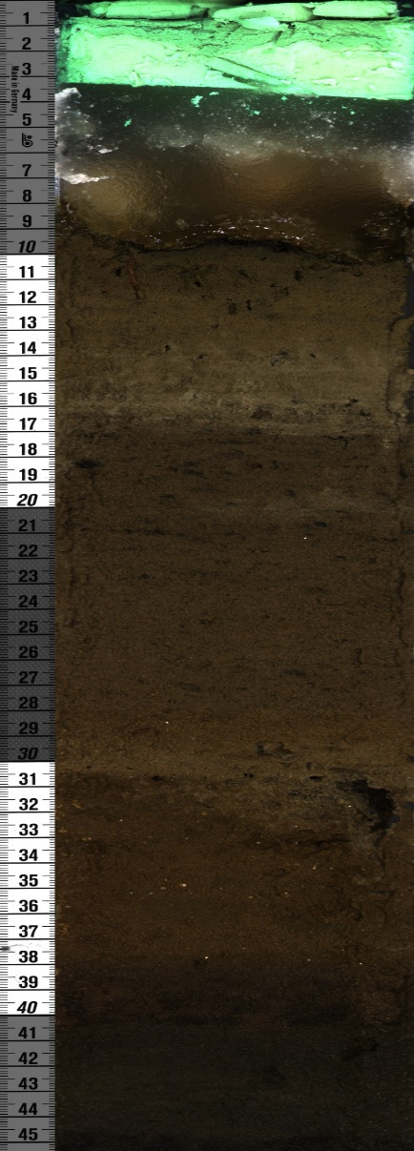
Core 1
Core 2
28 cm
23 cm

Slide 12
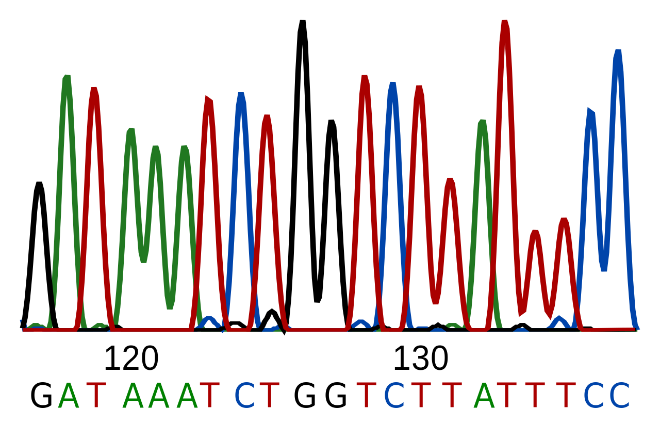


Future Direction and
Discussion

Slide 13
Acknowledgements
Bat Ecology and Genetics Lab
NASA Space Grant
Hooper Undergraduate Research Award (HURA)
Bilby Research Center
The Translational Genomics Research
Institute (TGen)
Contact Info
nau.edu/ancientDNA
snh248@nau.edu (my e-mail)
Faith.Walker@nau.edu

